Slide 1
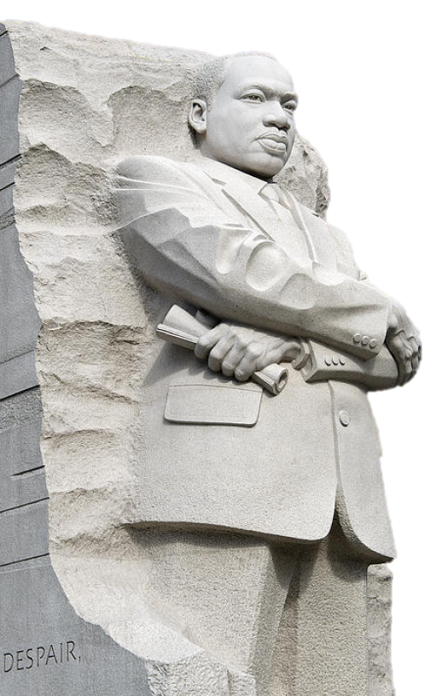
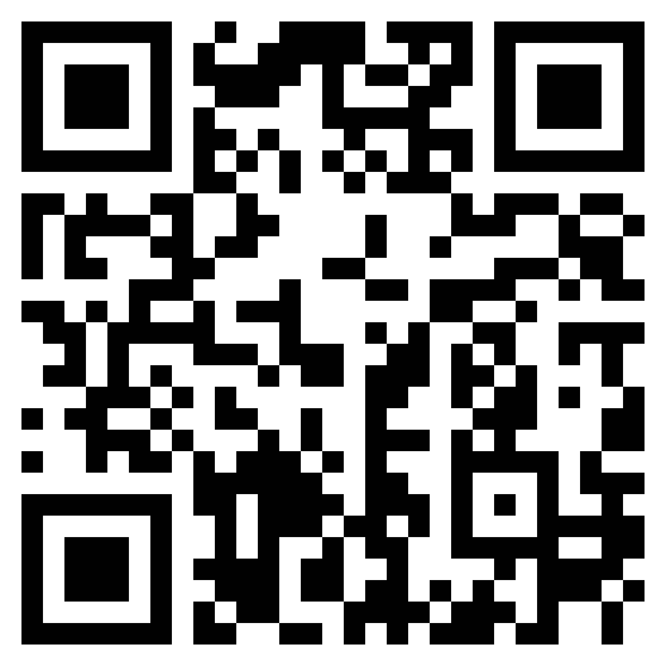
COMMUNITIES WORKING
TO UNITE YOUTH
CWUY
4th ANNUAL
I Remember Martin
FESTIVAL
SATURDAY, JANUARY 17, 2026
LOCATION: RANKIN COUNTY SAFE ROOM CONFERENCE CENTER
651 MARQUETTE ROAD, BRANDON MS 39042
10:00 A.M. – 12:00 P.M.
Join us in Celebrating
the Legacy of MLK.
We will enjoy
fellowship with
good food, fun
and family.
For more information contact:
cwuy4u.org or 601-454-2574
Come Show Your Support

